Slide 1

CS2005 Networks and Operating Systems Re-sit Exam Revision

Slide 2

The Exam
The exam lasts for 2.5 hours
There are SEVEN questions
You MUST attempt FOUR questions
All questions are marked as PASS/FAIL

Slide 3
Exam questions
Exam questions are essay style
How long should an answer be?
Should you include diagrams?

Slide 4
Exam questions
Exam questions are essay style
How long should an answer be?
Roughly 1 to 1.5 pages
Should you include diagrams?
Highly recommended

Slide 5
What is expected
It is expected to draw upon your reading and experience to answer the questions and give specific examples, with illustrations where appropriate.

Slide 6

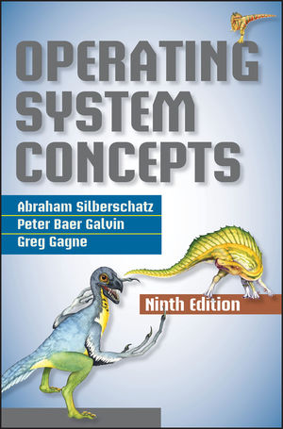
What is expected
It is expected to draw upon your reading (from the course books) and experience (practical lab exercises) to answer the questions and give specific examples, with illustrations (diagrams) where appropriate.

Slide 7


Marking scheme
A PASS in four questions results in a grade within the A band
A PASS in three questions results in a grade within the B band
A PASS in two questions results in a grade within the C band
A PASS in one question results in a grade within the D band
A FAIL in all 4 questions results in an F or E grade depending on the level to which the questions are failed, i.e. either not attempting a reasonable response (most likely to achieve an F) or attempting but not quite attaining a PASS (most likely to achieve an E).
Differentiation within a band will decided by the overall quality of the exam paper. If you achieve a grade within the A band and your answers are consistently of a very high standard, this will result in an A* grade.

Slide 8
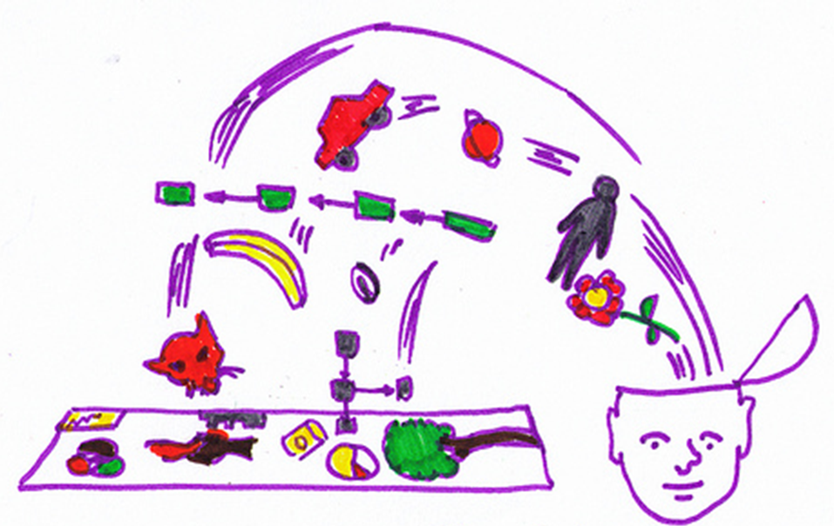
Approach
Practice with revisions questions (see next slides)
Essay structure is key (think about how you ANSWER THE QUESTION)
ANSWER THE QUESTION
Don’t brain dump!
i.e. spot a keyword in the question and write everything you know about it rather than answering the question
PASS/FAIL depends on your ability to answer the question

Slide 9
Topics
Application Layer
Transport Layer
Network Layer
Operating Systems Structures
Processes
Threads
Security

Slide 10
Revision Question Bank
7 Topics
2 Revision questions per topic
7 Exam questions based on the revision questions (1 per topic)
Exam answers will be essay style
Guidance for revision questions in the following slides

Slide 11
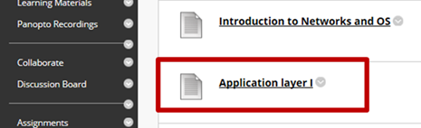
Application Layer Q1
“Discuss the two types of HTTP messages. Include in your discussion methods and header information. Explain how a client can get a web page with multiple objects that reside in the same server. In your answer include what factors might increase the overall time to load the web page.”
Refer to Computer Networking book…
2.2 (The Web and HTTP) [p. 126]
2.2.1 (Overview of HTTP) [p. 126]
2.2.2 (Non-Persistent and Persistent Connections) [p. 128]
2.2.3 (HTTP Message Format) [p. 131]
discussed in “Application layer I”

Slide 12
Application Layer Q1
Think about…
What is HTTP?
What transport protocol does HTTP use?
What are the two HTTP connection types?
Advantages / disadvantages
HTTP message format
Give examples of the main fields
HTTP response time
Give example (use diagram)

Slide 13
Web and HTTP
First, a review…
HTTP is defined in [v1.0-RFC 1945] and [v1.1-RFC 2616].
web page consists of objects
object can be HTML file, JPEG image, Java applet, audio file,…
web page consists of base HTML-file which includes several referenced objects
each object is addressable by a URL, e.g.,
www.someschool.edu/someDept/pic.gif
host name
path name

Slide 14


HTTP overview
HTTP: hypertext transfer protocol
Web’s application layer protocol
client/server model
client: browser that requests, receives, (using HTTP protocol) and “displays” Web objects
server: Web server sends (using HTTP protocol) objects in response to requests
HTTP request
PC running
Firefox browser
HTTP response
HTTP request
server
running
Apache Web
server
HTTP response
iPhone running
Safari browser

Slide 15
HTTP overview (cont.)
uses TCP:
client initiates TCP connection (creates socket) to server, port 80
server accepts TCP connection from client
HTTP messages (application-layer protocol messages) exchanged between browser (HTTP client) and Web server (HTTP server)
TCP connection closed
HTTP is “stateless”
server maintains no information about past client requests
aside
protocols that maintain “state” are complex!
past history (state) must be maintained
if server/client crashes, their views of “state” may be inconsistent, must be reconciled

Slide 16
HTTP connections
non-persistent HTTP
at most one object sent over TCP connection
connection then closed
downloading multiple objects required multiple connections
persistent HTTP
multiple objects can be sent over single TCP connection between client, server

Slide 17
Non-persistent HTTP
suppose user enters URL:
(contains text,
references to 10
jpeg images)
www.someSchool.edu/someDepartment/home.index
1a. HTTP client initiates TCP connection to HTTP server (process) at www.someSchool.edu on port 80
1b. HTTP server at host www.someSchool.edu waiting for TCP connection at port 80. “accepts” connection, notifying client
2. HTTP client sends HTTP request message (containing URL) into TCP connection socket. Message indicates that client wants object someDepartment/home.index
3. HTTP server receives request message, forms response message containing requested object, and sends message into its socket
time

Slide 18
Non-persistent HTTP (cont.)
4. HTTP server closes TCP connection.
5. HTTP client receives response message containing html file, displays html. Parsing html file, finds 10 referenced jpeg objects
time
6. Steps 1-5 repeated for each of 10 jpeg objects

Slide 19
Non-persistent HTTP: response time
RTT (definition): time for a small packet to travel from client to server and back
HTTP response time:
one RTT to initiate TCP connection
one RTT for HTTP request and first few bytes of HTTP response to return
file transmission time
non-persistent HTTP response time =
2RTT+ file transmission time
initiate TCP
connection
RTT
request
file
RTT
time to
transmit
file
file
received
time
time

Slide 20
Persistent HTTP
non-persistent HTTP issues:
requires 2 RTTs per object
OS overhead for each TCP connection
browsers often open parallel TCP connections to fetch referenced objects
persistent HTTP:
server leaves connection open after sending response
subsequent HTTP messages between same client/server sent over open connection
client sends requests as soon as it encounters a referenced object
as little as one RTT for all the referenced objects

Slide 21
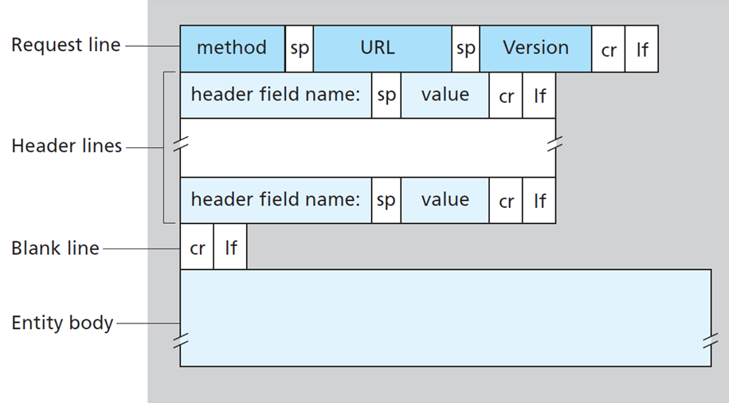
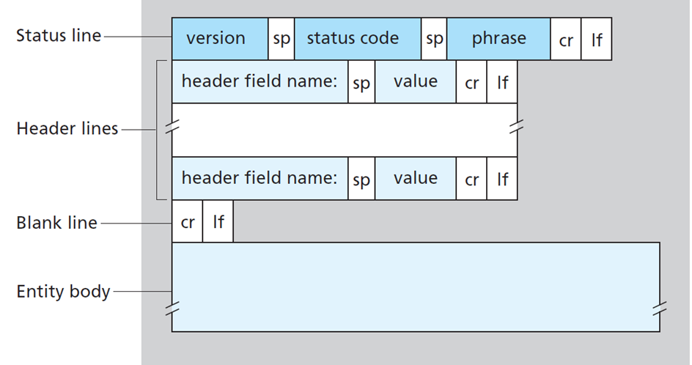
HTTP messages
two types of HTTP messages:
request
response

Slide 22
HTTP request message
general format
example
request line
(GET, POST,
HEAD commands)
GET /index.html HTTP/1.1\r\n
Accept: text/html,application/json\r\n
Accept-Language: en-us,en;q=0.5\r\n
Connection: keep-alive\r\n
……
\r\n
header lines
carriage return, line feed at start of line indicates end of header lines

Slide 23
HTTP response message
general format
example
status line (protocol, status code, status phrase)
HTTP/1.1 200 OK\r\n
Date: Sun, 26 Sep 2010 20:09:20 GMT\r\n
Content-Length: 2652\r\n
Content-Type: text/html\r\n
……
\r\n
data data data ...
header lines
data, e.g.,
Requested HTML file

Slide 24
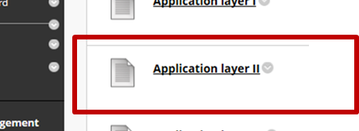
Application Layer Q2
“Alice wants to send an e-mail to Bob over the Internet Mail system. Discuss how this is accomplished. Refer to user agents, mail servers and the Simple Mail Transfer Protocol in your answer.”
Refer to Computer Networking book…
2.3 (Electronic Mail in the Internet) [p. 144]
2.3.1 (SMTP) [p. 146]
discussed in “Application layer II”

Slide 25
Application Layer Q2
Think about…
Internet electronic mail system major components
Use diagram
Main Internet electronic mail protocol
SMTP – Simple Mail Transfer Protocol
The process of sending a message
How each component is used
Use diagram
Think of SMTP phases of transferring a message

Slide 26
Application Layer Q2
user
agent
outgoing
message queue
mail
server
user
agent
user mailbox
SMTP
mail
server
user
agent
SMTP
SMTP
user
agent
mail
server
user
agent
user
agent

Slide 27
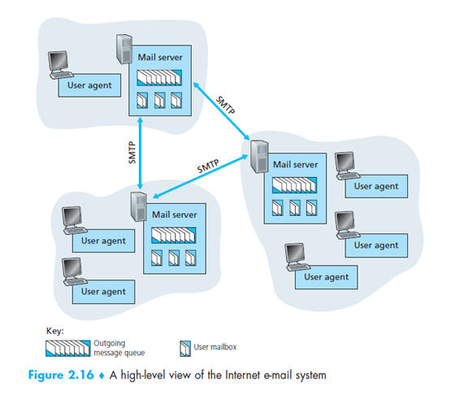
Application Layer Q2
Sixth edition
Seventh edition
Figure 2.14 A high-level view of the Internet e-mail system

Slide 28
Application Layer Q2
Three major components
user agents
“mail reader”
composing, editing, reading mail messages
e.g., Outlook, Thunderbird, iPhone mail client
outgoing, incoming messages stored on server
mail servers
mailbox contains incoming messages for user
message queue of outgoing (to be sent) mail messages
simple mail transfer protocol: SMTP
between mail servers to send email messages
“client”: sending mail server
“server”: receiving mail server

Slide 29
Application Layer Q2
Simple Mail Transfer Protocol: SMTP
uses TCP to reliably transfer email message from client to server, port 25
direct transfer: sending server to receiving server
three phases of transfer
handshaking (greeting)
transfer of messages
closure
command/response interaction (like HTTP)
commands: ASCII text
response: status code and phrase
messages must be in 7-bit ASCII

Slide 30


Describe process using the scenario: Alice sends message to Bob
Application Layer Q2
1) Alice uses UA to compose message “to” bob@someschool.edu
2) Alice’s UA sends message to her mail server; message placed in message queue
3) client side of SMTP opens TCP connection with Bob’s mail server
4) SMTP client sends Alice’s message over the TCP connection
5) Bob’s mail server places the message in Bob’s mailbox
6) Bob invokes his user agent to read message
1
user
agent
mail
server
user
agent
mail
server
2
3
6
4
Alice’s mail server
5
Bob’s mail server

Slide 31
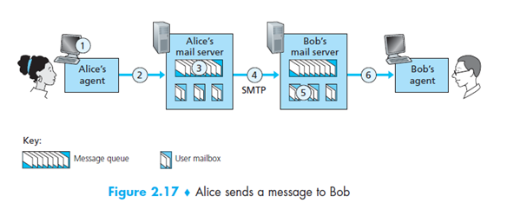
Application Layer Q2
Sixth edition
Figure 2.15 Alice sends a message to Bob
Seventh edition

Slide 32
Application Layer Q2
SMTP phases of transferring a message
handshaking (greeting)
e.g. HELO, MAIL FROM, RCPT TO
transfer of messages
DATA, how end of messages is indicated?
Closure
QUIT

Slide 33
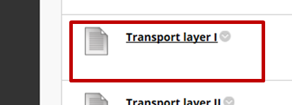
Transport Layer Q1
“Define Multiplexing and Demultiplexing in the Transport Layer. Discuss how Transport Layer segments are sent and received in connectionless and connection-oriented protocols.”
Refer to Computer Networking book…
3.2 (Multiplexing and Demultiplexing) [p. 221]
Read also
3.1 (Introduction and Transport Layer Services) [p. 216]
discussed in “Transport layer I”

Slide 34
Transport Layer Q1
Think about…
Key features of transport layer
Logical communication between application processes
Segmentation
Transport layer services
Multiplexing/demultiplexing
Reliable data transfer
…
Source / destination port numbers
Transport layer segment
Connectionless vs connection-oriented mux/demux
How sockets are identified
You may use code snippets as examples

Slide 35
Transport Layer Q1
multiplexing at sender:
demultiplexing at receiver:
handle data from multiple
sockets, add transport header (later used for demultiplexing)
use header info to deliver
received segments to correct
socket
application
application
P1
P2
application
socket
P3
transport
P4
process
transport
network
transport
network
link
network
link
physical
link
physical
physical

Slide 36
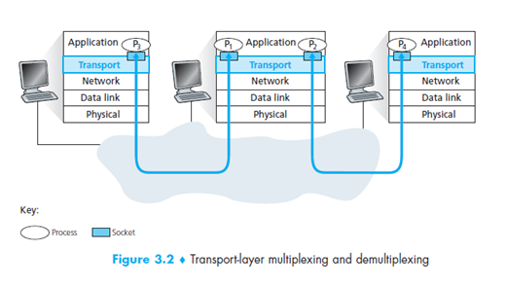
Transport Layer Q1

Slide 37
Transport Layer Q1
host receives IP datagrams
each datagram has source IP address, destination IP address
each datagram carries one transport-layer segment
each segment has source, destination port number
host uses IP addresses & port numbers to direct segment to appropriate socket
32 bits
source port #
dest port #
other header fields
application
data
(payload)
TCP/UDP segment format

Slide 38
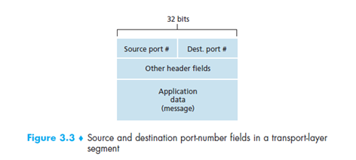
Transport Layer Q1

Slide 39
Transport Layer Q1
Connectionless
when creating datagram to send into UDP socket, must specify
destination IP address
destination port #
demux: receiver
checks destination port # in segment
directs UDP segment to socket with that port #
Connection-oriented
TCP socket identified by 4-tuple:
source IP address
source port number
dest IP address
dest port number
demux: receiver uses all four values to direct segment to appropriate socket

Slide 40
Transport Layer Q1
Python Examples:
UDP
clientSocket = socket(AF_INET, SOCK_DGRAM)
serverSocket.bind((‘’,serverPort))
TCP
clientSocket = socket(AF_INET, SOCK_STREAM)
serverSocket.bind((‘’,serverPort))

Slide 41
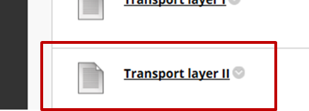
Transport Layer Q2
“Discuss how Sequence and Acknowledgement numbers play a key role in reliability in TCP. Explain this using a simple application example.”
Refer to Computer Networking book…
3.5 (Connection-Oriented Transport: TCP) [p. 261]
3.5.1 (The TCP Connection) [p. 261]
3.5.2 (TCP Segment Structure) [p. 264]
discussed in “Transport layer II”

Slide 42
Transport Layer Q2
Think about…
TCP
Overview and services
Connection
TCP Segment structure
Fields for Sequence and Acknowledgment numbers
Sequence and Acknowledgment numbers
Data: stream of bytes
Cumulative acknowledgments
Use example
Use diagram

Slide 43
Transport Layer Q2
Overview and services
point-to-point:
one sender, one receiver
Multicasting is not possible with TCP
connection-oriented:
handshaking (exchange of control msgs) initialises sender, receiver state before data exchange
full duplex data:
bi-directional data flow in same connection
MSS: maximum segment size
reliable, in-order byte steam:
Byte stream number
flow controlled:
sender will not overwhelm receiver
pipelined:
vs. stop and wait
TCP congestion and flow control set window size

Slide 44
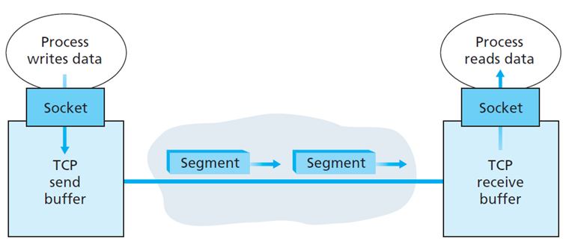
Transport Layer Q2
Connection
clientSocket.connect((serverName,serverPort))
When connection is established (three-way handshake)
TCP state variables are initialised
clientSocket.send(data)
Data transmission can start (stream of data)
TCP forms segment – header + data (size MSS)
MSS is determined by the largest possible frame (link-layer MTU)

Slide 45
Transport Layer Q2
TCP segment structure
32 bits
URG: urgent data
source port #
dest port #
counting
by bytes
of data
(not segments)
sequence number
ACK: ACK #
valid
acknowledgement number
head
len
not
used
U
receive window
A
P
R
S
F
PSH: push data now
# bytes receiver is willing to accept
checksum
Urg data pointer
RST, SYN, FIN:
connection estab
(setup, teardown
commands)
options (variable length)
application
data
(variable length)
Internet
checksum
(as in UDP)

Slide 46
Transport Layer Q2
Sequence and Acknowledgment numbers
sequence numbers:
byte stream “number” of first byte in segment’s data
acknowledgements:
seq # of next byte expected from other side
cumulative ACK
Q: how receiver handles out-of-order segments
A: TCP spec does not say, - up to implementor

Slide 47
Transport Layer Q2
Sequence and Acknowledgment numbers example
Host A
Host B
User
types
‘C’
Seq=42, ACK=79, data = ‘C’
host ACKs
receipt of
‘C’, echoes
back ‘C’
Seq=79, ACK=43, data = ‘C’
Seq=43, ACK=80

Slide 48
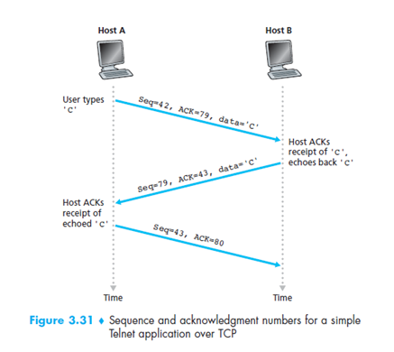
Transport Layer Q2
Sequence and Acknowledgment example

Slide 49
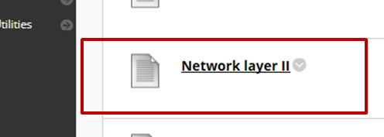
Network Layer Q1
“Define what is meant by the terms datagram and fragment. Discuss how IP Datagram Fragmentation works using a worked example (assume IPv4).”
Refer to Computer Networking book…
4.3.1 (IPv4 Datagram Format) [p. 358]
4.3.2 (IPv4 Datagram Fragmentation) [p. 360]
discussed in “Network layer II”

Slide 50
Network Layer Q1
Think about…
IP Datagram (IPv4)
Format
Fields related to datagram fragmentation
Datagram Fragmentation / Reassembly
Why?
Where?
How?
Give example
Use diagram

Slide 51
Transport Layer Q2
IP Datagram format
IP protocol version
number
32 bits
total datagram
length (bytes)
header length
(bytes)
head.
len
type of
service
ver
length
for
fragmentation/
reassembly
“type” of data
flgs
fragment
offset
16-bit identifier
max number
remaining hops
(decremented at
each router)
time to
live
upper
layer
header
checksum
32 bit source IP address
upper layer protocol
to deliver payload to
32 bit destination IP address
options (if any)
e.g. timestamp,
record route
taken, specify
list of routers
to visit.
how much overhead?
20 bytes of TCP
20 bytes of IP
= 40 bytes + application layer overhead
data
(variable length,
typically a TCP
or UDP segment)

Slide 52
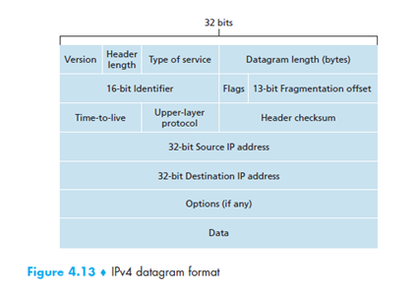
Network Layer Q1
IP Datagram format
Sixth edition
Figure 4.16 IPv4 datagram format
Seventh edition

Slide 53
Network Layer Q1
Datagram Fragmentation / Reassembly
Why?
Different Maximum Transmission Unit (MTU)
Where?
Fragmentation at routers
Reassembly at destination host
How?
Use the related datagram fields to explain

Slide 54
Network Layer Q1
Datagram Fragmentation / Reassembly
network links have MTU (maximum transmission unit) - largest possible link-level frame
different link types, different MTUs
large IP datagram divided (“fragmented”) within net
one datagram becomes several datagrams
“reassembled” only at final destination
IP header bits used to identify, order related fragments
…
fragmentation:
in: one large datagram
out: 3 smaller datagrams
reassembly
…

Slide 55
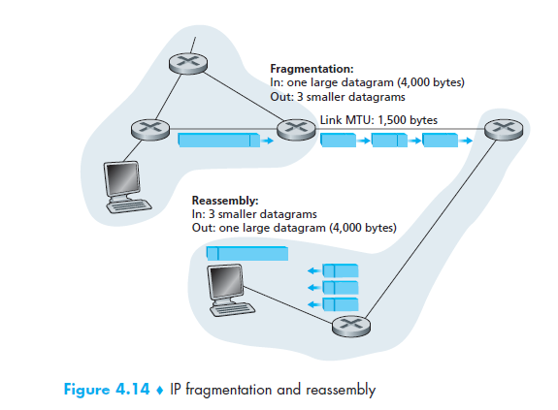
Network Layer Q1
Datagram Fragmentation / Reassembly
Sixth edition
Figure 4.17 IP fragmentation and reassembly
Seventh edition

Slide 56
Network Layer Q1
Datagram Fragmentation / Reassembly – EXAMPLE
length
=4000
ID
=x
fragflag
=0
offset
=0
example:
4000 byte datagram
MTU = 1500 bytes
one large datagram becomes
several smaller datagrams
1480 bytes in data field
length
=1500
ID
=x
fragflag
=1
offset
=0
offset =
1480/8
length
=1500
ID
=x
fragflag
=1
offset
=185
length
=1040
ID
=x
fragflag
=0
offset
=370

Slide 57
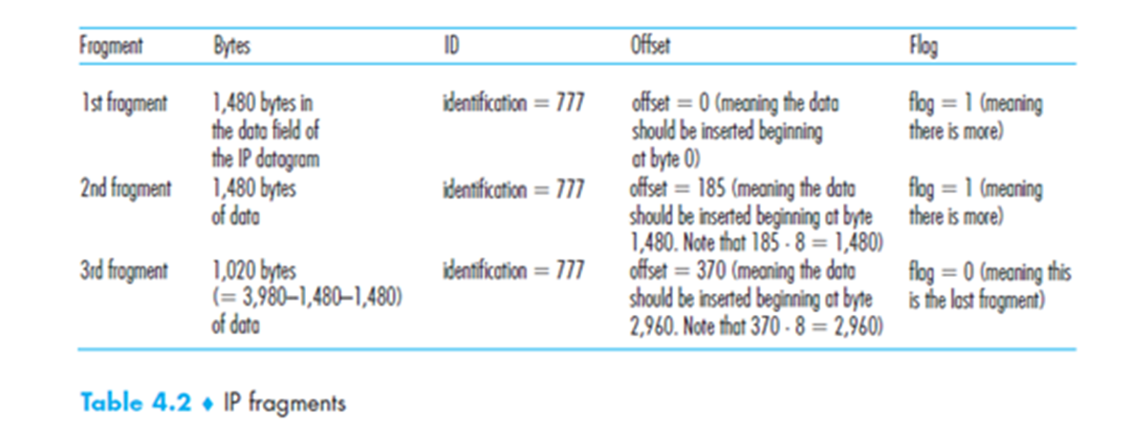
Network Layer Q1
Datagram Fragmentation / Reassembly – EXAMPLE
Sixth edition
Description of Figure 4.17
Seventh edition

Slide 58
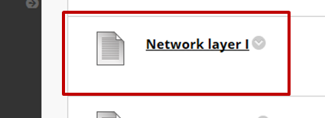
Network Layer Q2
“Define forwarding and routing in the Network Layer. In your answer include where these functions take place considering both the traditional and the SDN approaches. Discuss what services the Network Layer could provide and what is the Internet’s service model.”
Refer to Computer Networking book…
4.1 (Overview of Network Layer) [p. 334]
4.1.1 (Forwarding and Routing: The data and Control Planes) [p. 334]
4.1.2 (Network Service Model) [p. 339]
discussed in “Network layer I”

Slide 59
Network Layer Q2
Think about…
Forwarding
Routing
Data Plane
Control Plane
Network service model

Slide 60
















Network layer
application
transport
network
data link
physical
transport segment from sending to receiving host
on sending side encapsulates segments into datagrams
on receiving side, delivers segments to transport layer
network layer protocols in every host, router
router examines header fields in all IP datagrams passing through it
network
data link
physical
network
data link
physical
network
data link
physical
network
data link
physical
network
data link
physical
network
data link
physical
network
data link
physical
network
data link
physical
network
data link
physical
application
transport
network
data link
physical
network
data link
physical
network
data link
physical

Slide 61
Two key network layer functions
network layer functions:
forwarding: move packets from router’s input to appropriate router output
routing: determine route taken by packets from source to destination
using routing algorithms
analogy:
forwarding: process of getting through single interchange
routing: process of planning trip from source to destination

Slide 62
Routing and forwarding
Control
routing algorithm
routing algorithm determines
end-end-path through network
local forwarding table
forwarding table determines
local forwarding at this router
Data
header value
output link
0100
0101
0111
1001
3
2
2
1
value in arriving
packet’s header
0111
1
3
2

Slide 63
Network layer: data plane / control plane
Data plane
local, per-router function
determines how datagram arriving on router input port is forwarded to router output port
forwarding function
Control plane
network-wide logic
determines how datagram is routed among routers along end-to-end path from source host to destination host
two control-plane approaches:
traditional routing algorithms: implemented in routers
software-defined networking (SDN): implemented in (remote) servers
values in arriving
packet header
0111
1
3
2

Slide 64

Per-router control plane
Individual routing algorithm components in each and every router interact in the control plane
Routing
Algorithm
control
plane
data
plane
values in arriving
packet header
0111
1
3
2

Slide 65
Logically centralised control plane
A distinct (typically remote) controller interacts with local control agents (CAs)
Remote Controller
control
plane
data
plane
CA
CA
CA
CA
CA
values in arriving
packet header
0111
1
3
2

Slide 66
Network service model
Q: What service model for “channel” transporting datagrams from sender to receiver?
example services for individual datagrams:
guaranteed delivery
guaranteed delivery with less than 40 msec delay
example services for a flow of datagrams:
in-order datagram delivery
guaranteed minimum bandwidth to flow
restrictions on changes in inter-packet spacing

Slide 67
Network layer service model
Network
Architecture
Internet
ATM
ATM
ATM
ATM
Service
Model
best effort
CBR
VBR
ABR
UBR
Guarantees ?
Congestion
feedback
no (inferred
via loss)
no
congestion
no
congestion
yes
no
Bandwidth
none
constant
rate
guaranteed
rate
guaranteed
minimum
none
Loss
no
yes
yes
no
no
Order
no
yes
yes
yes
yes
Timing
no
yes
yes
no
no

Slide 68

Security Q1
“Discuss FOUR types of accidental or malicious security violations and THREE levels at which security measures could be taken.”
Refer to Operating Systems Concepts book…
15.1 (The Security Problem) [p. 657]
discussed in “Security I”

Slide 69
Security Q1
Think about…
Security violations
Types
Methods
Security measures
Levels

Slide 70
Security Q1
Security violations types (4 out of 5)
Breach of confidentiality.
Involves unauthorised access to data (or theft of information). For examples, credit-card information, identity information, etc.
Breach of integrity.
Involves unauthorised modification of data. For example, change the content of a website, change the text of a message, etc.
Breach of availability.
Involves unauthorised destruction of data. For example, website defacement, etc.
Theft of service.
Involves unauthorised use of resources. For example, an intruder (or intrusion program) may install a daemon on a system that acts as a file server.
Denial of service.
Involves preventing legitimate use of the system. Denial-of-service (DOS) by overwhelming the service with illegitimate traffic.

Slide 71
Security Q1
Security violations methods
Masquerading: one participant in a communication pretends to be someone else (another host or another person).
This is breach of authentication, gaining access that would not normally be allowed or obtaining privileges to which would not normally be entitled.
Replay attack: consists of the malicious or fraudulent repeat of a valid data transmission.
e.g. repeat of a request to transfer money, frequently along with message modification.
Man-in-the-middle attack: an attacker sits in the data flow of a communication, masquerading as the sender to the receiver, and vice versa.
Session hijacking: intercept an active communication to bypass authentication.

Slide 72
Security Q1
Security measure levels (3 out of 4)
Impossible to have absolute security, but make cost to perpetrator sufficiently high to deter most intruders
Security must occur at four levels to be effective:
Physical
Data centers, servers, connected terminals
Human
Avoid social engineering, phishing, dumpster diving
Operating System
Protection mechanisms, debugging
Network
Intercepted communications, interruption, DOS
Security is as weak as the weakest link in the chain

Slide 73
Security Q2
“Discuss THREE types of Program Threats. Give an example for each one.”
Refer to Operating Systems Concepts book…
15.2 (Program Threats) [p. 661]
discussed in “Security I”

Slide 74
Security Q2
Think about…
What are program threats?
Three examples
One for each method you discuss

Slide 75
Security Q2
Programme threats (3 out of 5)
Trojan Horse
Pretend to be something else, e.g. login is system
Can block, modify, delete data
Install backdoor
Can not self-replicate
Trap Door
Leave a “hole” for accessing the system, e.g. hardcoded credentials
Logic Bomb
Activated under certain circumstances, e.g. at specific date/time
Stack and Buffer Overflow
Writes arguments into the return address on stack
Viruses
A fragment of code embedded in a legitimate program
Can self-replicate
Can spread over a network – infect other machines

Slide 76
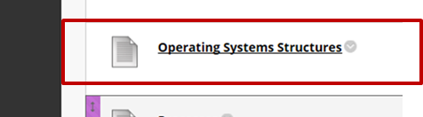
Operating Systems Structures Q1
“Discuss TWO approaches users can use to interact with an Operating System. Discuss FIVE Operating System services and discuss the function each provides.”
Refer to Operating Systems Concepts book…
2.1 (Operating-System Services) [p. 55]
discussed in “Operating Systems Structures”

Slide 77
Operating Systems Structures Q1
Think about…
Services available to users and programs

Slide 78
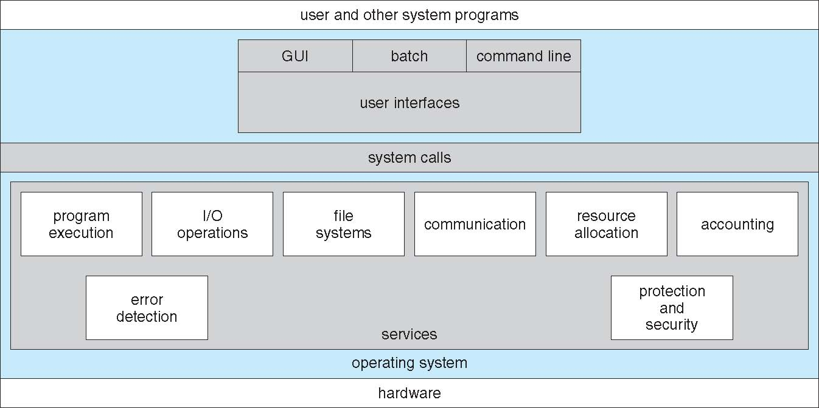
(2.1) Operating System Services (OSS) Operating systems provide an environment for execution of programs and services to programs and users
Let’s go through the above…

Slide 79
Main OSS functions
User interface.
Almost all operating systems have a user interface (UI). Can have a command-line interface (CLI), a batch interface, and/or a graphical user interface (GUI).
Program execution.
The system must be able to load a program into memory and to run that program. The program must be able to end its execution, either normally or abnormally (indicating error).
I/O operations.
A running program may require I/O, which may involve a file or an I/O device (e.g. screen, DVD, etc.). Users usually cannot control I/O devices directly. Therefore, the operating system must provide a means to do I/O.
File-system manipulation.
Programs need to read and write files and directories. They also need to create and delete them by name, search for a given file, and list file information. Finally, some operating systems include permissions management to allow or deny access to files or directories based on file ownership

Slide 80
Main OSS functions
Communications.
There are many circumstances in which one process needs to exchange information with another process. Such communication may occur between processes that are executing on the same computer or between processes that are executing on different computer systems tied together by a computer network. Communications may be implemented via shared memory, in which two or more processes read and write to a shared section of memory, or message passing, in which packets of information in predefined formats are moved between processes by the operating system.
Error detection.
The operating system needs to detect and correct errors constantly. Errors may occur in the CPU and memory hardware (such as a memory error or a power failure), in I/O devices (such as a parity error on disk, a connection failure on a network, or lack of paper in the printer), and in the user program (such as an arithmetic overflow, an attempt to access an illegal memory location, or a too-great use of CPU time). Correction might involve halting the system or terminating a process.

Slide 81
Main OSS functions
Resource allocation.
When there are multiple users or multiple jobs running at the same time, resources must be allocated to each of them. The operating system manages many different types of resources. Some (such as CPU cycles, main memory, and file storage) may have special allocation code, whereas others (such as I/O devices) may have much more general request and release code. For instance, in determining how best to use the CPU, operating systems have CPU-scheduling routines that take into account the speed of the CPU, the jobs that must be executed, the number of registers available, and other factors.
Accounting.
We want to keep track of which users use how much and what kinds of computer resources. This record keeping may be used for accounting (so that users can be billed) or simply for accumulating usage statistics.
Protection and security.
The owners of information stored in a multiuser or networked computer system may want to control use of that information. When several separate processes execute concurrently, it should not be possible for one process to interfere with the others or with the operating system itself. Protection involves ensuring that all access to system resources is controlled. Security of the system from outsiders is also important. Such security starts with requiring each user to authenticate himself or herself to the system, usually by means of a password, to gain access to system resources.

Slide 82
Operating Systems Structures Q2
“Discuss what System Programs are and how they are different from Application Programs. Using examples, explain the functionality of FIVE categories of System Programs.”
Refer to Operating Systems Concepts book…
2.5 (System Programs) [p. 74]
discussed in “Operating Systems Structures”

Slide 83
Operating Systems Structures Q2
Think about…
What is the structure of a computer system?
What are System Programs?
What is their purpose?
Services provided by System Programs?
What is their difference from Application Programs?
What are their functionalities?
Examples?

Slide 84
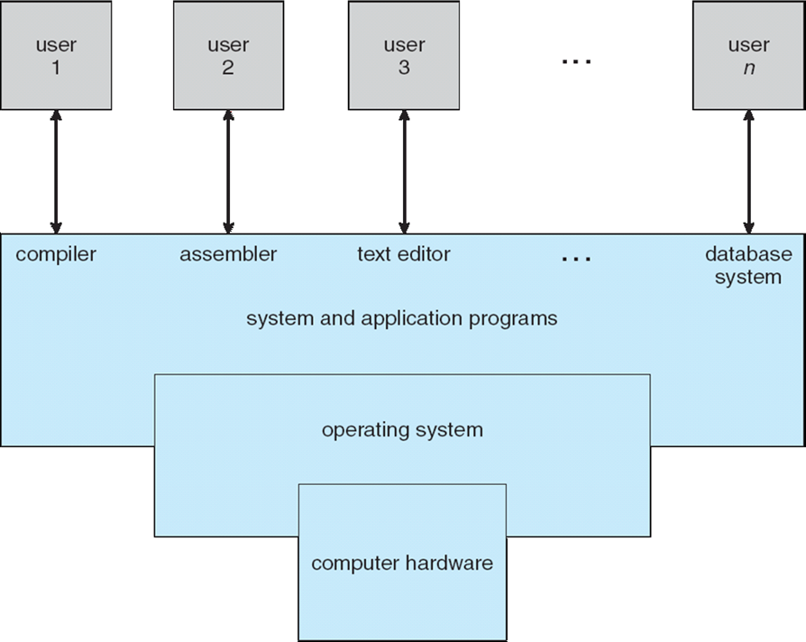
Structure of a Computer System

Slide 85
System Programs (Basically utilities to aid program development and execution – many form the functionality of CLI and Batch environments – these make system calls as well)
Program loading and execution
Once a program is assembled or compiled, it must be loaded into memory to be executed… loaders, linkers, debuggers, etc.
Communications
These programs provide the mechanism for creating virtual connections among processes, users, and computer systems. They allow users to send messages to one another’s screens, to browse Web pages, to send e-mail messages, to log in remotely, or to transfer files from one machine to another.
Background services.
All general-purpose systems have methods for launching certain system-program processes at boot time. Some of these processes terminate after completing their tasks, while others continue to run until the system is halted. Constantly running system-program processes are known as services, subsystems, or daemons. Include schedulers, system monitors, printer servers, etc.

Slide 86
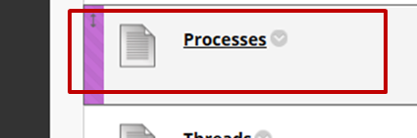
Processes Q1
“What is a “Process” and what are its possible states? What are the possible actions a process might take in its lifecycle? Discuss the role of the Process Control Block.”
Refer to Operating Systems Concepts book…
3.1 (Process Concept) [p. 105]
3.1.1 (The Process) [p. 106]
3.1.2 (Process State) [p. 107]
3.1.3 (Process Control Block) [p. 107]
discussed in “Processes”

Slide 87
Processes Q1
Think about…
What is a process?
What is the structure of a process in memory?
What are the five states that a process can be in?
Recall the state diagram..
What is the Process Control Block (PCB)?
Example?

Slide 88
Processes Q2
“How is a process scheduled in an operating system? Your answer should consider the relationship between the process lifecycle, process control blocks, scheduler queues and the operating system scheduler.”
Refer to Operating Systems Concepts book…
3.1.2 (Process States) [p. 107]
3.1.3 (Process Control Block) [p. 107]
3.2 (Process Scheduling) [p. 110]
discussed in “Processes”

Slide 89
Processes Q2
Think about…
What are the five states that a process can be in?
Recall the state diagram..
What information is held in the Process Control Block (PCB)?
How many scheduling queues are there?
Give an example in relation to the process lifecycle
What is a operating system scheduler?
Types
Objectives

Slide 90
Process Concept
What is a process?
Jobs, user programs, operating system programs, tasks, unit of work, etc.
Essentially a program that is being executed on an operating system
A program converted into an executable (file) becomes a process when it is run and loaded into memory

Slide 91
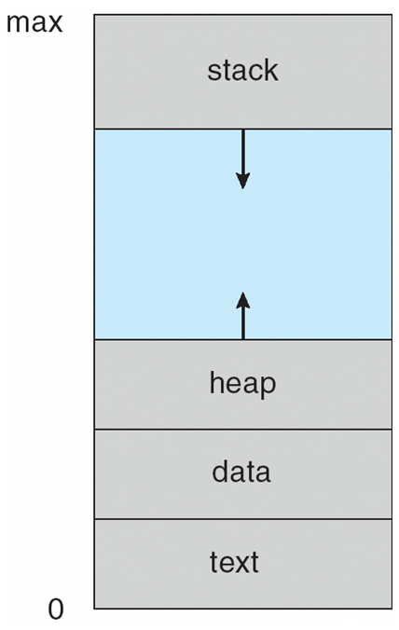
What is a Process made of?
Text
Program code + current activity status (value of the program counter and processors’ (CPU, etc.) registers
Stack
Temporary data (such as function parameters, return addresses, local variables, etc.)
Data
Global variables
Heap
Memory dynamically allocated during process run time
0… Max denote memory allocated for the process

Slide 92
Process State
As a process executes, it changes state.
New. The process is being created
Running. Instructions are being executed
Waiting. The process is waiting for some event to occur (such as an I/O completion or reception of a signal)
Ready. The process is waiting to be assigned to a processor
Terminated. The process has finished execution
(These names are arbitrary, and they vary across operating systems)
Only one process can be Running at any time
Many processes can be Ready and Waiting

Slide 93
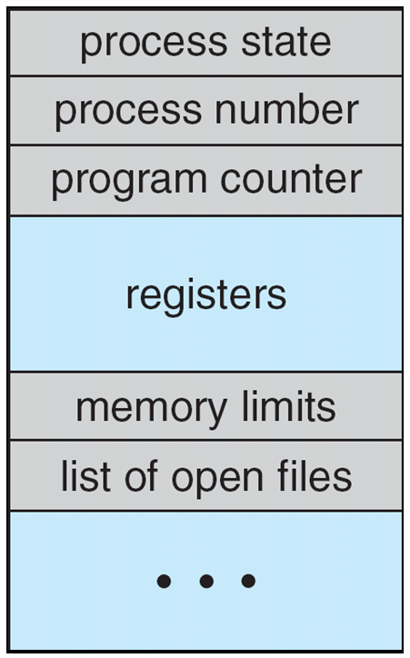
Process Control Block Each process is represented in the OS by a Process Control Block (PCB)
Process state (New, ready, running, waiting, etc.)
Program counter (The counter indicates the address of the next instruction to be executed for this process)
CPU registers (The registers vary in number and type, depending on the computer architecture. They include accumulators, index registers, stack pointers, and general-purpose registers, plus any condition-code information)
CPU-scheduling information (This information includes process priority, pointers to scheduling queues, and any other scheduling parameters)
Memory-management information (This information may include such items as the value of the base and limit registers and the page tables, or the segment tables, depending on the memory system used by the operating system)
Accounting information (This information includes the amount of CPU and real time used, time limits, account numbers, job or process numbers, and so on)
I/O status information (This information includes the list of I/O devices allocated to the process, a list of open files, and so on)

Slide 94
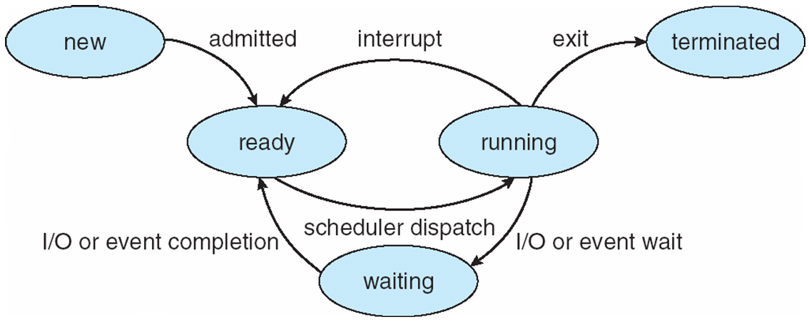
Process State and PCB
Essentially the Process Control Block of a Process is updated whenever the process changes state.

Slide 95
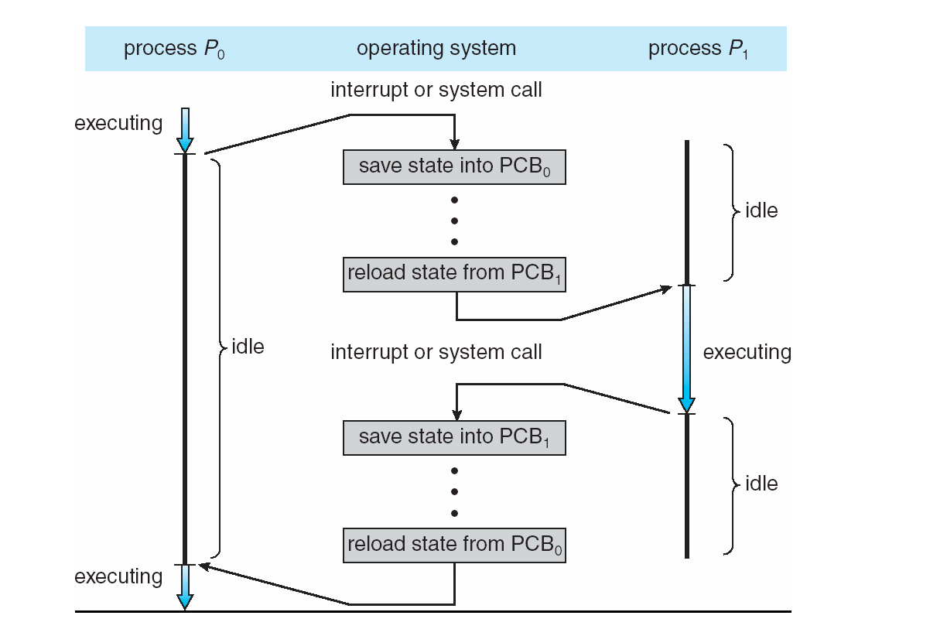
Example: When a process stops running for whatever reason its process status is changed and then its state is saved into its PCB

Slide 96
Process Scheduling
The process scheduler is responsible for choosing and running processes
When a process is allocated, the CPU it executes for a while and eventually quits, is interrupted, or waits for the occurrence of a particular event, such as the completion of an I/O request.
The process scheduler needs a job queue, a ready queue, a device queue and others (we will worry about the first three)
Job queue
Consists of all processes in the system.
Ready queue
Processes that are residing in main memory and are ready and waiting to execute
Device queue
A process wishes to make an I/O request to a shared device (e.g. disk, screen, keyboard, printer, drone, killer penguin, etc.) The device might be busy dealing with another process’ I/O request.
A device queue is therefore the list of processes waiting to use that device.
Queues are generally stored as a linked list
E.g. a ready-queue header contains pointers to the first and final PCBs in the list. Each PCB includes a pointer field that points to the next PCB in the ready queue.

Slide 97
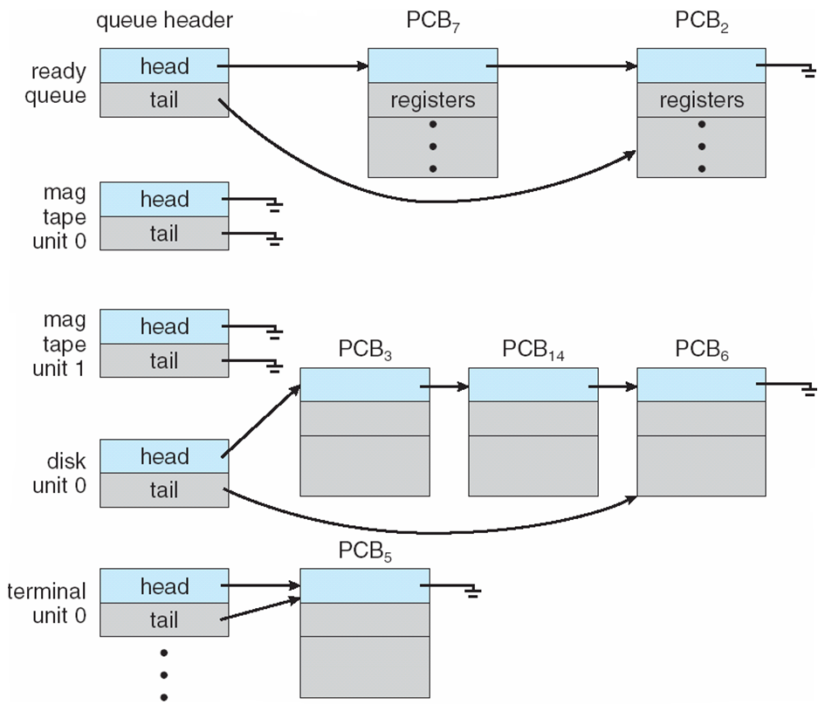
Process Scheduler Queues
Device queues

Slide 98
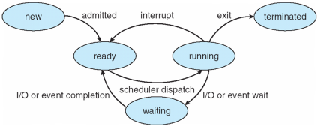
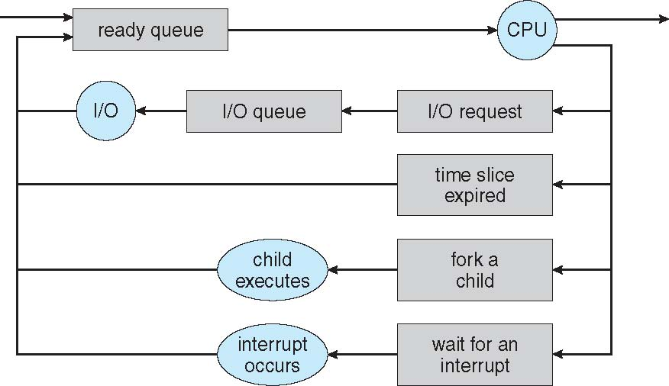
Scheduler Queuing/Lifecycle Diagram
REMEMBER!
REMEMBER!
READY
RUNNING
Selected/Dispatched
TERMINATED
WAITING
WAITING
WAITING
Ready queue
Device queue

Slide 99

Example Process “Life”
READY
RUNNING
Selected/Dispatched
TERMINATED
WAITING
WAITING
WAITING

Slide 100
Example Process “Life”
READY
RUNNING
Selected/Dispatched
TERMINATED
WAITING
WAITING
WAITING

Slide 101
Example Process “Life”
READY
RUNNING
Selected/Dispatched
TERMINATED
WAITING
WAITING
WAITING

Slide 102
Example Process “Life”
READY
RUNNING
Selected/Dispatched
TERMINATED
WAITING
WAITING
WAITING

Slide 103
Example Process “Life”
READY
RUNNING
Selected/Dispatched
TERMINATED
WAITING
WAITING
WAITING

Slide 104
Example Process “Life”
READY
RUNNING
Selected/Dispatched
TERMINATED
WAITING
WAITING
WAITING

Slide 105
Example Process “Life”
READY
RUNNING
Selected/Dispatched
TERMINATED
WAITING
WAITING
WAITING

Slide 106
Example Process “Life”
READY
RUNNING
Selected/Dispatched
TERMINATED
WAITING
WAITING
WAITING

Slide 107
Example Process “Life”
READY
RUNNING
Selected/Dispatched
TERMINATED
WAITING
WAITING
WAITING

Slide 108
Example Process “Life”
READY
RUNNING
Selected/Dispatched
TERMINATED
WAITING
WAITING
WAITING

Slide 109
Example Process “Life”
READY
RUNNING
Selected/Dispatched
TERMINATED
WAITING
WAITING
WAITING

Slide 110
Schedulers
Short-term scheduler (or CPU scheduler)
Selects which process should be executed next and allocates CPU
Sometimes the only scheduler in a system
Short-term scheduler is invoked frequently (milliseconds) ⇒ (must be fast)
Long-term scheduler (or job scheduler)
Selects which processes should be brought into the ready queue
Long-term scheduler is invoked infrequently (seconds, minutes) ⇒ (may be slow)
The long-term scheduler controls the degree of multiprogramming
Processes can be described as either:
I/O-bound process – spends more time doing I/O than computations, many short CPU bursts
CPU-bound process – spends more time doing computations; few very long CPU bursts
Long-term scheduler strives for good process mix

Slide 111
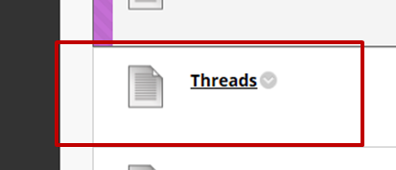
Threads Q1
“What is the difference between a single threaded process and a multi-threaded process? Discuss, using detailed examples, THREE key benefits of threads when compared to single threaded approaches.”
Refer to Operating Systems Concepts book…
4.1 (Overview) [p. 163]
discussed in “Threads”

Slide 112
Threads Q1
Think about…
What is a thread?
Single-threaded vs. multithreaded process
Concurrent vs. parallel
Benefits of multithreaded programming (THREE out of FOUR)
Examples

Slide 113
What is a Thread?
A thread is a basic unit of CPU utilization
Consists of a thread ID, a program counter, a register set, and a stack.
It shares with other threads belonging to the same process its code section, data section, and other operating system resources (e.g. files, etc.)
A traditional (or heavyweight) process has a single thread of control
If a process has multiple threads of control, it can perform more than one task at a time.
single-threaded process vs a multithreaded process...

Slide 115
Concurrent or parallel?
Web server
Looks parallel but often it is implemented through concurrent threads
Parallel implementation via proxies (i.e. redirection to other servers)

Slide 116
Benefits of Threads
Responsiveness
Multithreading an interactive application may allow a program to continue running even if part of it is blocked or is performing a lengthy operation
Resource sharing
Processes can only share resources through techniques such as shared memory and message passing. Threads share the memory and the resources of the process to which they belong by default. The benefit of sharing code and data is that it allows an application to have several different threads of activity within the same address space.
Economy
Allocating memory and resources for process creation is costly. Because threads share the resources of the process to which they belong, it is more economical to create and context-switch threads (e.g. in Solaris creating a process is about thirty times slower than is creating a thread, context switching is about five times slower).
Scalability
The benefits of multithreading can be even greater in a multiprocessor architecture, where threads may be running in parallel on different processing cores. A single-threaded process can run on only one processor, regardless how many are available.

Slide 117
Threads Q2
“What are the main states of a Java Thread? Discuss the lifecycle of a Java Thread and how it shares run time with other Threads.”
Refer to Operating Systems Concepts book…
4.4.3 (Java Threads) [p. 176]
Slides on Java Threads
discussed in “Threads”

Slide 118
Threads Q2
Think about…
What are threads
How are threads created?
Java threads states
Java threads lifecycle

Slide 119
To recap…
Threads…
Basically they allow an object (a process) to do things apparently in parallel (actually concurrently), i.e. two or more things at the “same” time.
A thread is a…
Facility to allow multiple activities within a single process
as “lightweight” process
is a series of executed statements
Each thread has its own program counter, stack and local variables and shares memory, files and per-process state with other threads

Slide 120
Creating (invoking) a Thread
A program starts with a single “main” thread of execution
Creating (invoking) a thread will split (fork) this main thread into two paths of execution
One path will execute the thread and the other path will follow the statement after the thread invocation (there will be a separate stack and memory space for each thread)
WARNING
Be careful with threads as concurrency can make shared, common variables unstable. Also, too many threads is bad for performance (but conversely, a few threads are good!)

Slide 121
Thread Scheduling
An operating system runs multiple threads on a CPU in some order. The swapping of threads to share the CPU is called scheduling.
(And yes the process in which the threads are running is being scheduled on the CPU as well!)
Normally, the runnable thread with the highest priority is active (running). Java is priority-preemptive - if a high-priority thread wakes up, and a low-priority thread is running, then the high-priority thread gets to run immediately. This means “on-demand” processing and the potentially efficient use of the CPU.

Slide 122
Thread Lifecycle
Object.notify() or Object.notifyAll()
Waiting
Object.notify() or Object.notifyAll()
Sleeping
Thread.sleep()
Object.wait()
Ready to run
Running
Chosen by scheduler
start()
Scheduler swap or Thread.yield()
Blocks for I/O or enters Synchronized code
stop() or run() exits
Data received or obtains a Lock
Dead
Blocked
Another thread closes IO socket

Slide 123


AND

